Slide 1

Complex ALU
Saikot Das Joy

Slide 2




Arithmatic Logic Unit(ALU)
Project goal:
The ALU unit must take two 4 bit binary data as Input.
Must perform:
→ Logical “AND” operation
→Logical “OR” operation
→Logical “NAND” operation
→Logical “NOR” operation
→Logical “XOR” operation
→Logical “XNOR” operation
→Logical “NOT” operation
Additional tasks to Perform:
→Binary “ADDITION”
→Binary “Substraction”
→Binary “Multiplication”
→Binary “DIVISION”

Slide 3
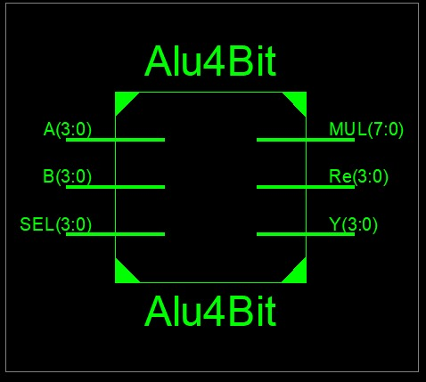
Block DIagram
1st Binary number input
2nd Binary number input
3rd Binary number input
Multiplication Output
Reminder after Binary division
Output for all other operation

Slide 4
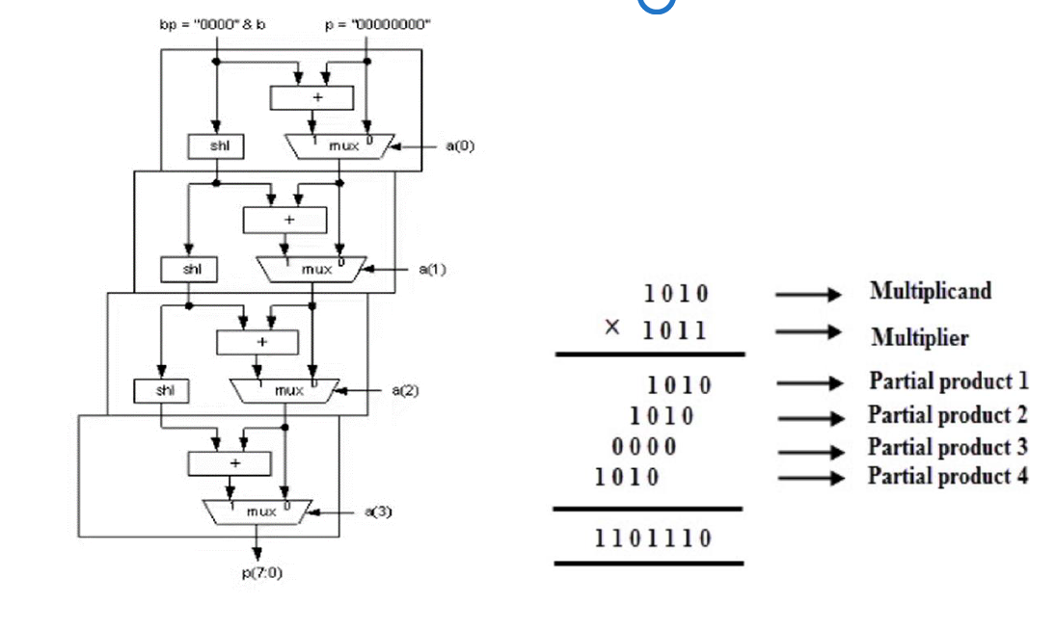
4 bit Binary Multiplication Algorithm

Slide 5
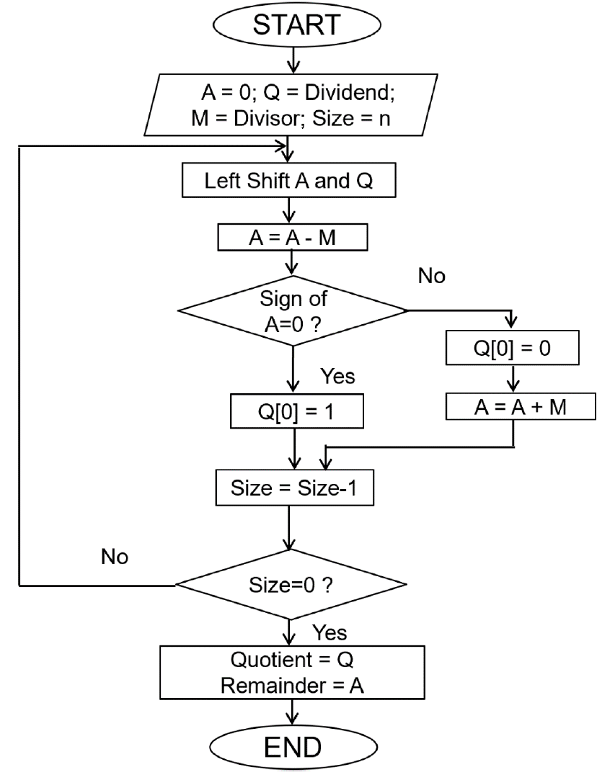
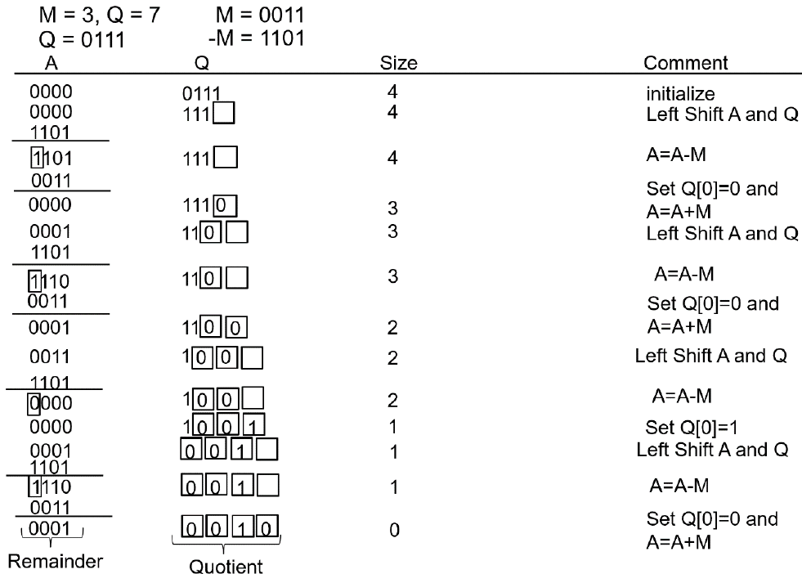
4 Bit Binary Division Algorithm

Slide 6
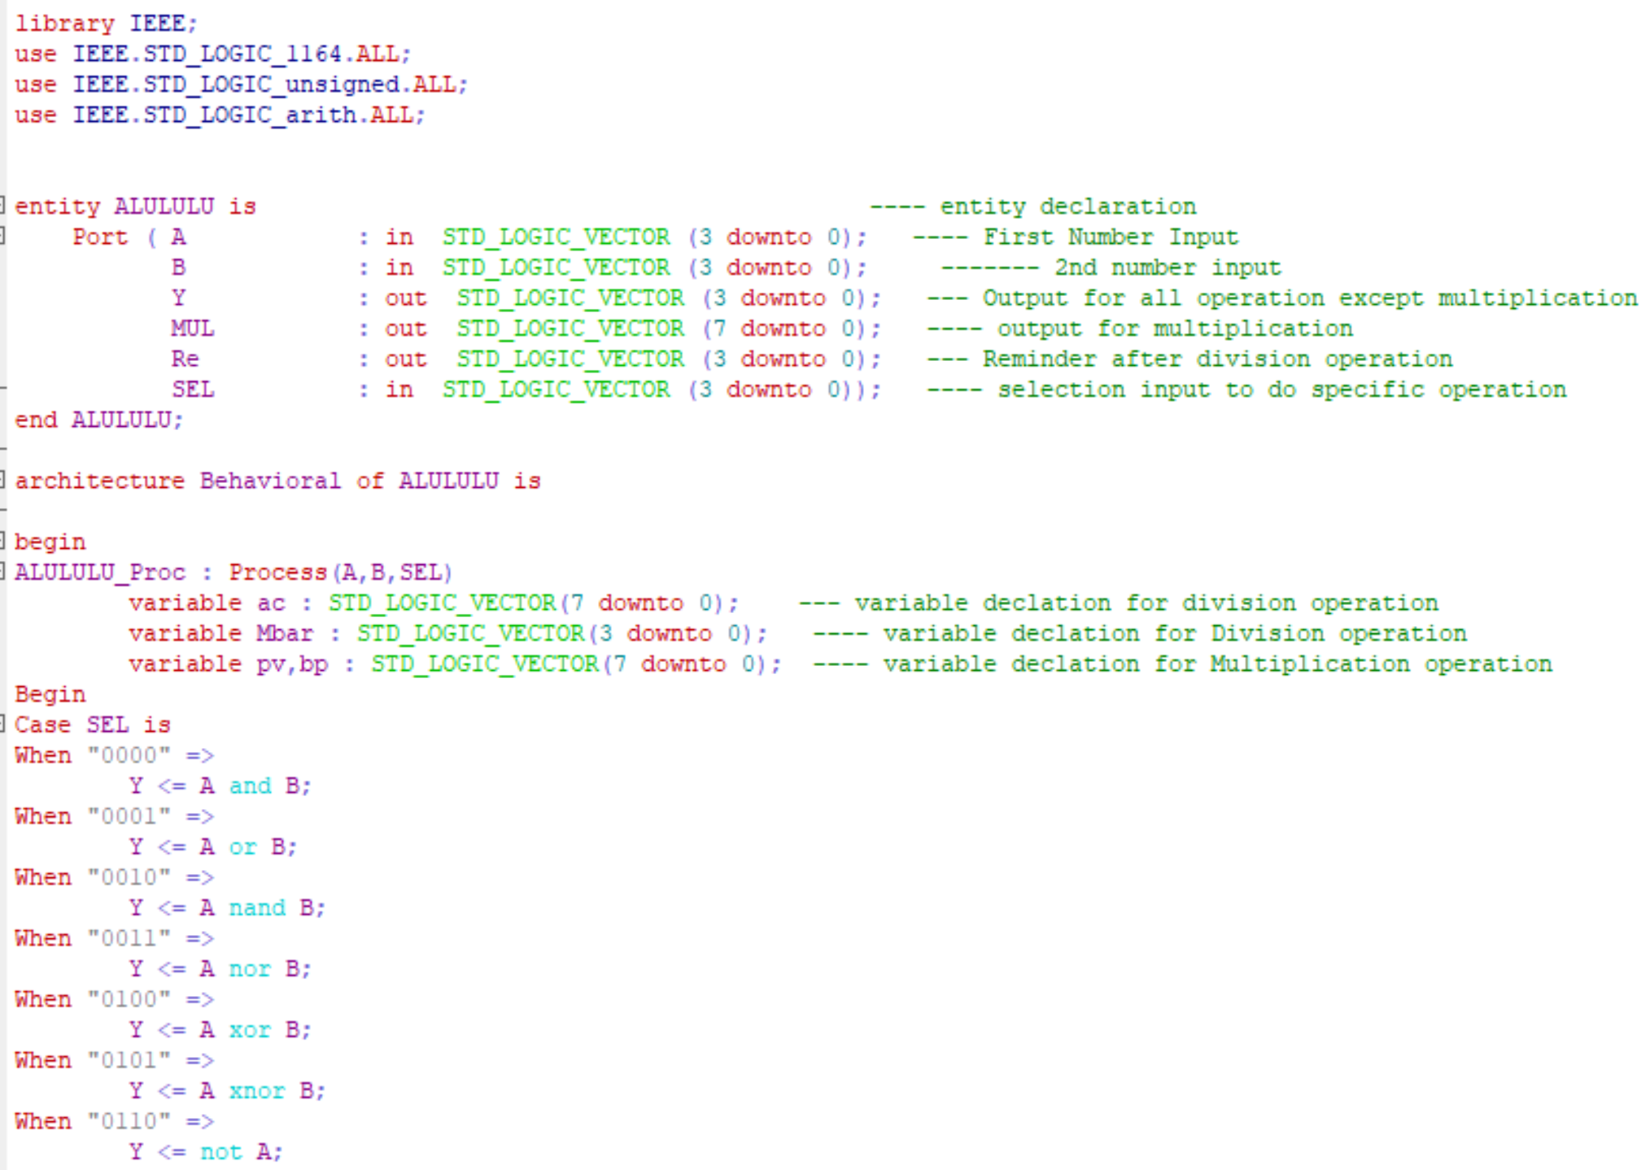
Implementation in VHDL

Slide 7
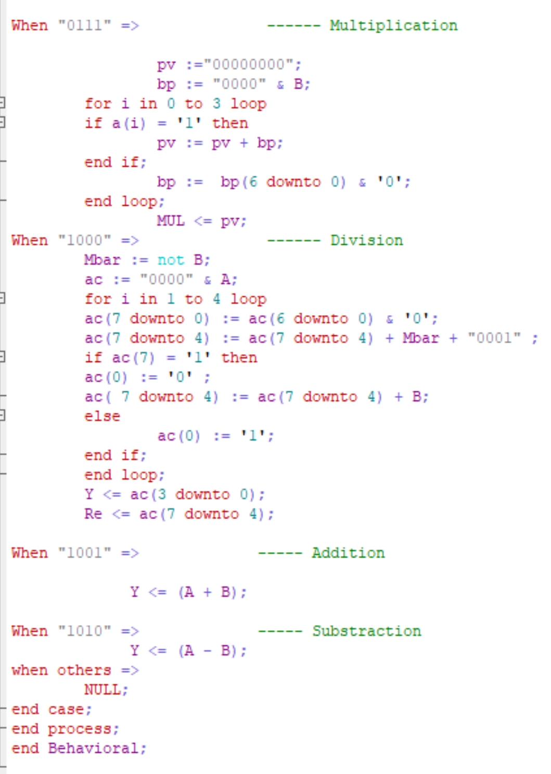

Slide 8
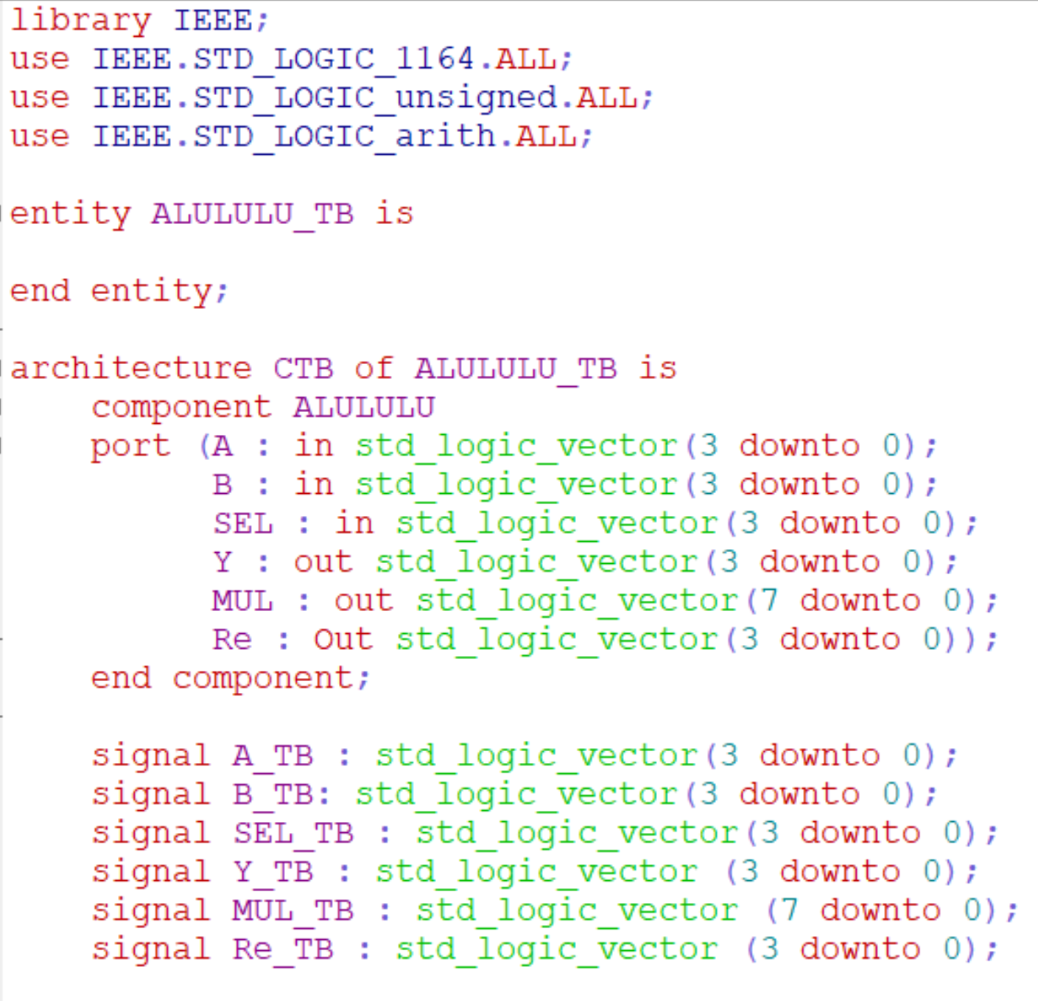
VHDL test_Bench

Slide 9
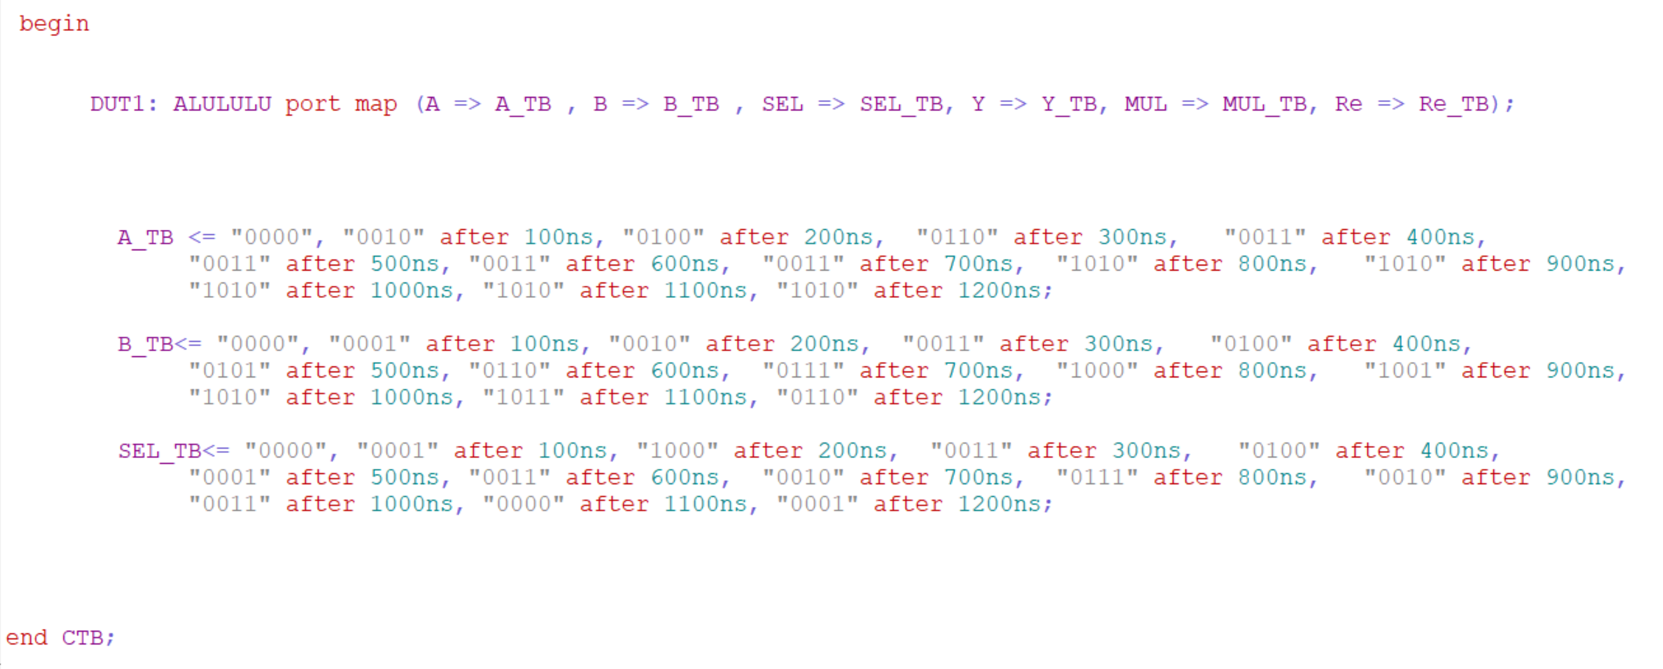

Slide 10
References
Digital Design Using Digilent Fpga Boards Vhdl/ Active - HDL Edition by Richard E. Haskell (2009-05-03)
https://electrobinary.blogspot.com/2020/08/restoring-division-verilog-code.html

Slide 11


